Slide 1
Relational Databases
Advanced Databases
Dr Shazia A Afzal

Slide 2
ER Modelling – Analysis Stage

Slide 3
E-R Model Constructs
Entities:
Entity instance–person, place, object, event, concept (often corresponds to a row in a table)
Entity Type–collection of entities (often corresponds to a table)
Relationships:
Relationship instance–link between entities (corresponds to primary key-foreign key equivalencies in related tables)
Relationship type–category of relationship…link between entity types
Attributes:
Properties or characteristics of an entity or relationship type (often corresponds to a field in a table)
Notes:
2

Slide 4
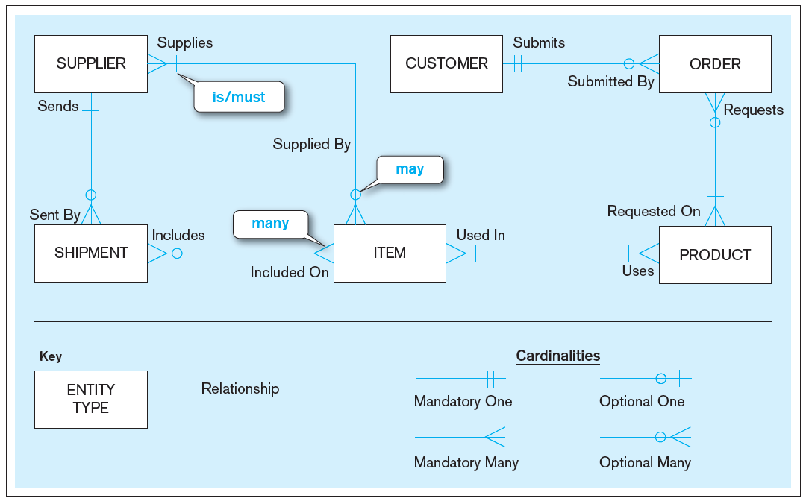
Sample E-R Diagram
Notes:
3
Entity relationship (ER) diagrams include rectangles representing entities, and lines between the entities representing relationships. Relationships have cardinalities, which can be one-to-one, one-to-many, or many-to-many. In addition, on each side of the relationship you can specify that it is mandatory or optional.

Slide 5
Business Rules
Are statements that define or constrain some aspect of the business
Are derived from policies, procedures, events, functions
Assert business structure
Control/influence business behavior
Are expressed in terms familiar to end users
Are automated through DBMS software
Notes:
A business rule is a statement that defines or constrains some aspect of the business. It is intended to assert business structure or to control or influence the behavior of the
business.
Not all business rules are implemented in a database, and it is the responsibility of the database analyst to determine which business rules can be expressed through ER models and which cannot.

Slide 6
A Good Business Rule Is:
Declarative–what, not how
Precise–clear, agreed-upon meaning
Atomic–one statement
Consistent–internally and externally
Expressible–structured, natural language
Distinct–non-redundant
Business-oriented–understood by business people
Notes:
Business rules appear (possibly implicitly) in descriptions of business functions, events, policies, units, stakeholders, and other objects. These descriptions can be found in interview notes from individual and group information systems requirements collection sessions, organizational documents (e.g., personnel manuals, policies, contracts, marketing brochures, and technical instructions), and other sources. Rules are identified by asking questions about the who, what, when, where, why, and how of the organization.
Gathering business rules requires good interviewing and listening skills. As a database analyst, you will ask questions about the who, what, when, where, why, and how of the organization. You’ll need to be persistent in clarifying initial statements of rules because initial statements may be vague or imprecise, so this is an iterative inquiry process.

Slide 7
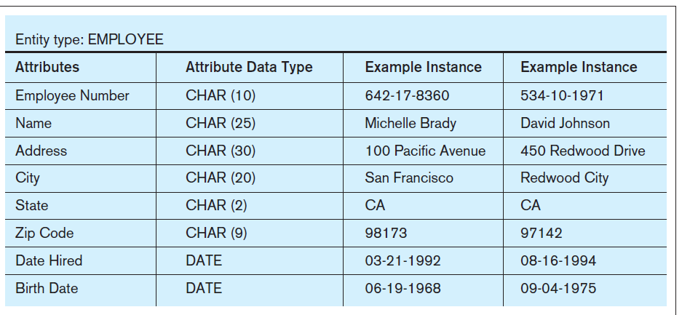
Entity Type and Entity Instances
Notes:
Here we see the distinction between an entity type and an entity instance. The entity type is represented in the first two columns of this figure. It includes the names of the various attributes (remember what we talked about regarding data names), as well as the types of data. By contrast, the third and fourth columns represent two entity instances. These would be actual records (or rows) in the final database table that implements this entity type.

Slide 8
An Entity…
SHOULD BE:
An object that will have many instances in the database
An object that will be composed of multiple attributes
An object that we are trying to model
SHOULD NOT BE:
A user of the database system
An output of the database system (e.g., a report)

Slide 9
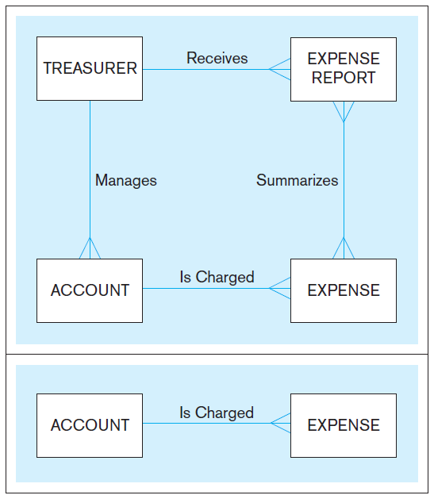
Example of inappropriate entities
System
user
System output
Inappropriate entities
Appropriate entities

Slide 10
Strong vs. Weak Entities, and Identifying Relationships
Strong entity
exists independently of other types of entities
has its own unique identifier
identifier underlined with single line
Weak entity
dependent on a strong entity (identifying owner)…cannot exist on its own
does not have a unique identifier (only a partial identifier)
entity box and partial identifier have double lines
Identifying relationship
links strong entities to weak entities
Shown by solid line or by double line (depending on the tool)

Slide 11
Guidelines for Naming and Defining Entities
Names:
Singular noun
Specific to organization
Concise, or abbreviation
For event entities, the result not the process
Name consistent for all diagrams
Notes:
5

Slide 12
Attributes
Attribute–property or characteristic of an entity or relationship type
Classifications of attributes:
Required versus Optional Attributes
Simple versus Composite Attribute
Single-Valued versus Multivalued Attribute
Stored versus Derived Attributes
Identifier Attributes
Notes:
5

Slide 13
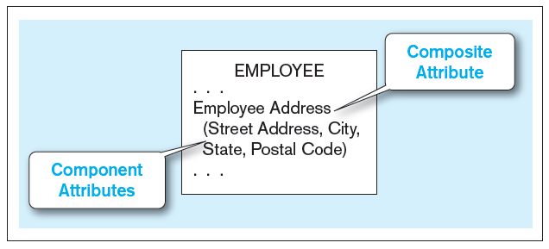
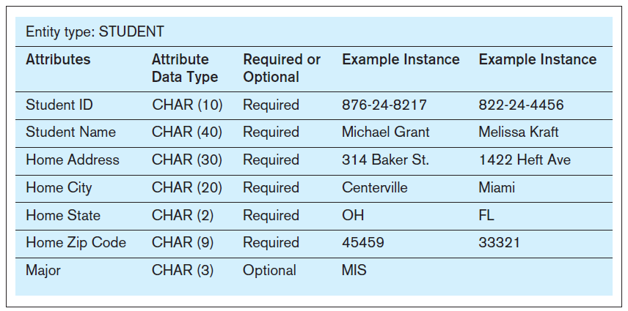
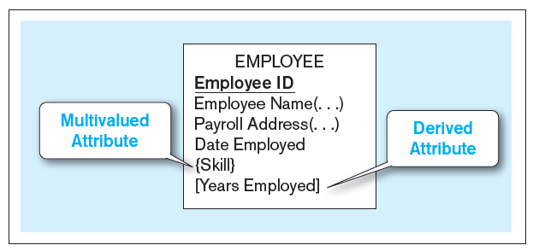
Attributes
Required – must have a value for every entity (or relationship) instance with which it is associated
Optional – may not have a value for every entity (or relationship) instance with which it is associated
Notes:
5

Slide 14
Identifiers (Keys)
Identifier (Key)–an attribute (or combination of attributes) that uniquely identifies individual instances of an entity type. Simple versus Composite Identifier
Candidate Identifier–an attribute that could be an identifier…satisfies the requirements for being an identifier
Choose Identifiers that
Will not change in value
Will not be null
Avoid intelligent identifiers (e.g., containing locations or people that might change)
Substitute new, simple keys for long, composite keys
Notes:
6

Slide 15
Modeling Relationships
Relationship Types vs. Relationship Instances
The relationship type is modeled as lines between entity types…the instance is between specific entity instances
Relationships can have attributes
These describe features pertaining to the association between the entities in the relationship
Two entities can have more than one type of relationship between them (multiple relationships)
Associative Entity–combination of relationship and entity

Slide 16
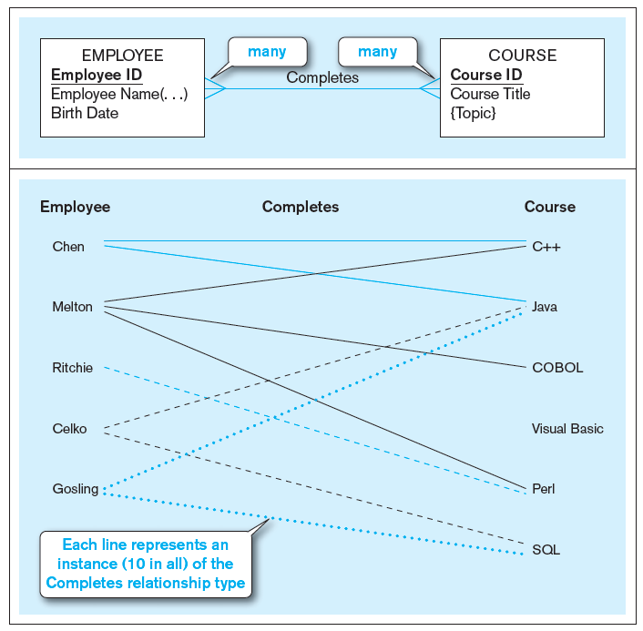
Relationship types and instances
a) Relationship type (Completes)
b) Relationship instances
Notes:
17

Slide 17
Degree of Relationships
Degree of a relationship is the number of entity types that participate in it
Unary Relationship
Binary Relationship
Ternary Relationship
Notes:
16
Most relationships are of binary degree. But it is possible to have any number of entities involved in a relationship “Ternary” refers to three. If you have more than that, it is sometimes referred to generically as an “n-ary” relationship.

Slide 18
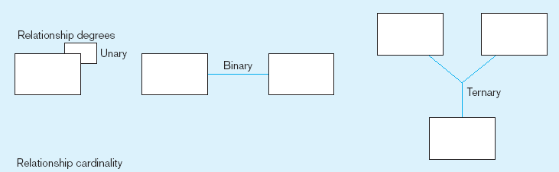
Degree of relationships
Entities of two different types related to each other
One entity related to another of the same entity type
Entities of three different types related to each other
Notes:
8

Slide 19
Cardinality of Relationships
One-to-One
Each entity in the relationship will have exactly one related entity
One-to-Many
An entity on one side of the relationship can have many related entities, but an entity on the other side will have a maximum of one related entity
Many-to-Many
Entities on both sides of the relationship can have many related entities on the other side

Slide 20
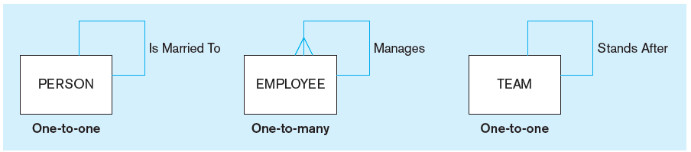
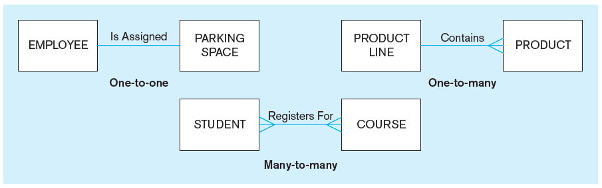
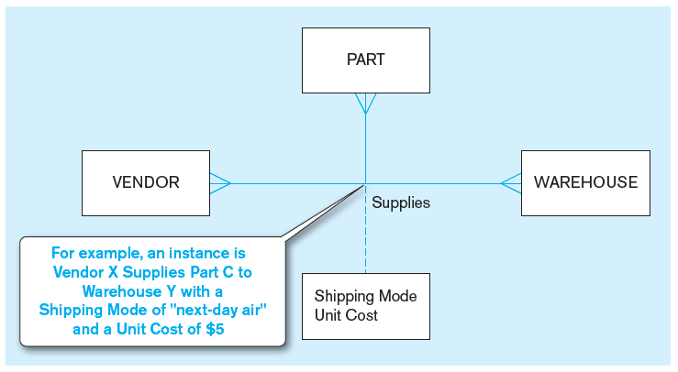
Examples of relationships of different degrees
a) Unary relationships
b) Binary relationships
c) Ternary relationship
Notes:
22

Slide 21
Cardinality Constraints
Cardinality Constraints—the number of instances of one entity that can or must be associated with each instance of another entity
Minimum Cardinality
If zero, then optional
If one or more, then mandatory
Maximum Cardinality
The maximum number
Notes:
29

Slide 22
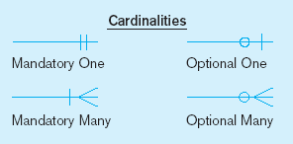
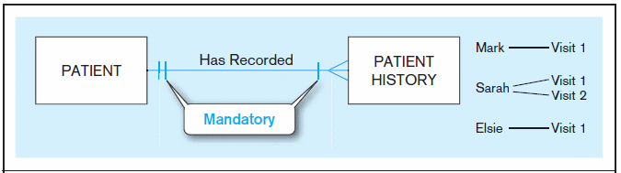
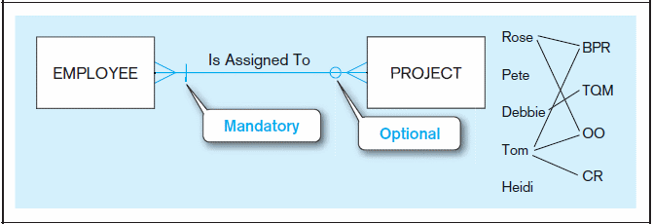
Examples of cardinality constraints
a) Mandatory cardinalities
b) One optional, one mandatory
A patient must have recorded at least one history, and can have many
A patient history is recorded for one and only one patient
Notes:
1

Slide 23
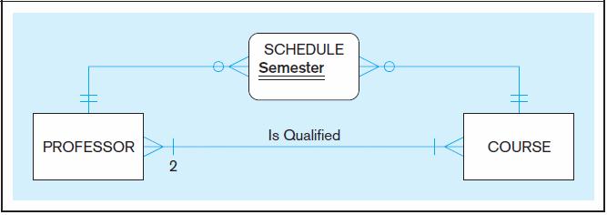
Examples of multiple relationships (cont.)
Professors and courses (fixed lower limit constraint)
Here, min cardinality constraint is 2. At least two professors must be qualified to teach each course. Each professor must be qualified to teach at least one course.
Notes:
40
Again, we see multiple relationships between two entities, this time between professors and courses. The “Is Qualified” relationship is of binary degree and mandatory many-to-many cardinality. A professor must be qualified to teach at least one course. And a course must have at least two qualified professors.
The other relationship is actually implemented via what is called an “associative entity” called Schedule, which has an identifier attribute called Semester. This associative entity is implementing a many to many relationship between professors and courses, indicating that a particular professor may be scheduled during a particular semester to many courses, and vice versa.

Slide 24
Associative Entities
An entity–has attributes
A relationship–links entities together
When should a relationship with attributes instead be an associative entity?
All relationships for the associative entity should be many
The associative entity could have meaning independent of the other entities
The associative entity preferably has a unique identifier, and should also have other attributes
The associative entity may participate in other relationships other than the entities of the associated relationship
Ternary relationships should be converted to associative entities

Slide 25
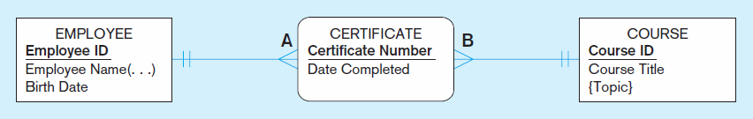
An associative entity (CERTIFICATE)
Associative entity is like a relationship with an attribute, but it is also considered to be an entity in its own right.
Note that the many-to-many cardinality between entities has been replaced by two one-to-many relationships with the associative entity.
Notes:
21

Slide 26
EER Modelling

Slide 27
Supertypes and Subtypes
Enhanced ER model: extends original ER model with new modeling constructs
Subtype: A subgrouping of the entities in an entity type that has attributes distinct from those in other subgroupings
Supertype: A generic entity type that has a relationship with one or more subtypes
Attribute Inheritance:
Subtype entities inherit values of all attributes of the supertype
An instance of a subtype is also an instance of the supertype
Notes:
The ideas of supertypes, subtypes and inheritance, which are central to the EER model, are also key concepts in object-oriented software design and programming. If you ever use an object-oriented programming language like Java or C++, you will encounter the concept of classes, which are similar to “types”. These classes are arranged in hierarchies, which enable inheritance.
The difference between object-oriented programming and EER supertypes/subtypes is that in object oriented programming there is also the concept of behavior. Objects not only have attributes (which can be inherited), but they also have “methods” which implement active behaviors.

Slide 28
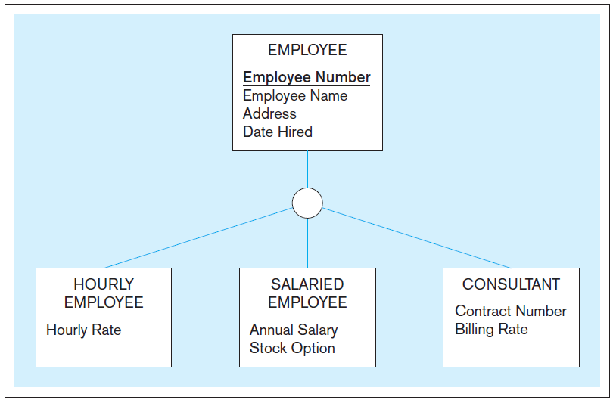
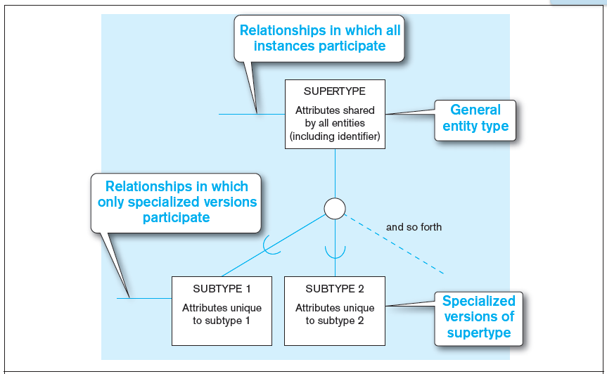
Basic notation for supertype/subtype notation
EER notation

Slide 29
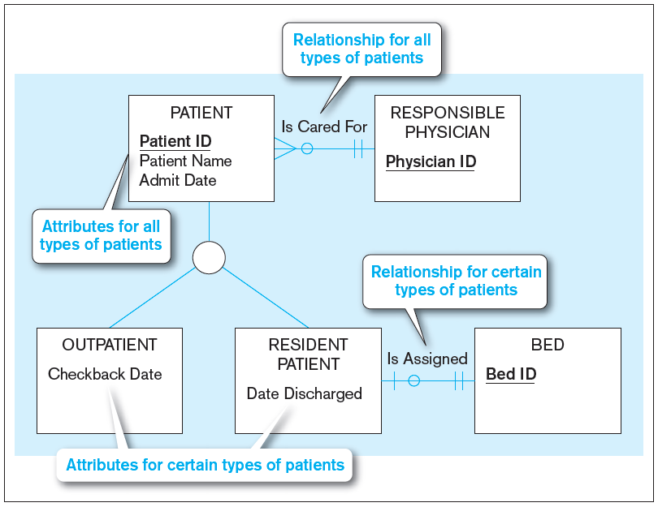
Relationships and Subtypes
Relationships at the supertype level indicate that all subtypes will participate in the relationship
The instances of a subtype may participate in a relationship unique to that subtype. In this situation, the relationship is shown at the subtype level

Slide 30
Generalization and Specialization
Generalization: The process of defining a more general entity type from a set of more specialized entity types. BOTTOM-UP
Specialization: The process of defining one or more subtypes of the supertype and forming supertype/subtype relationships. TOP-DOWN

Slide 31
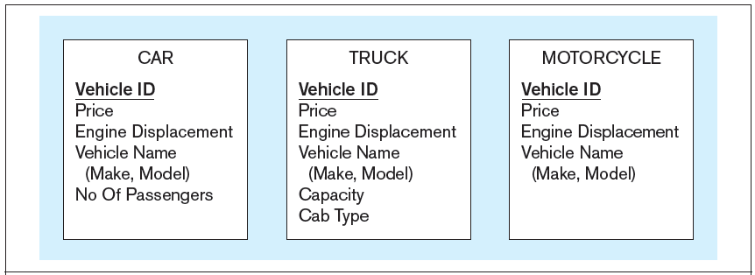
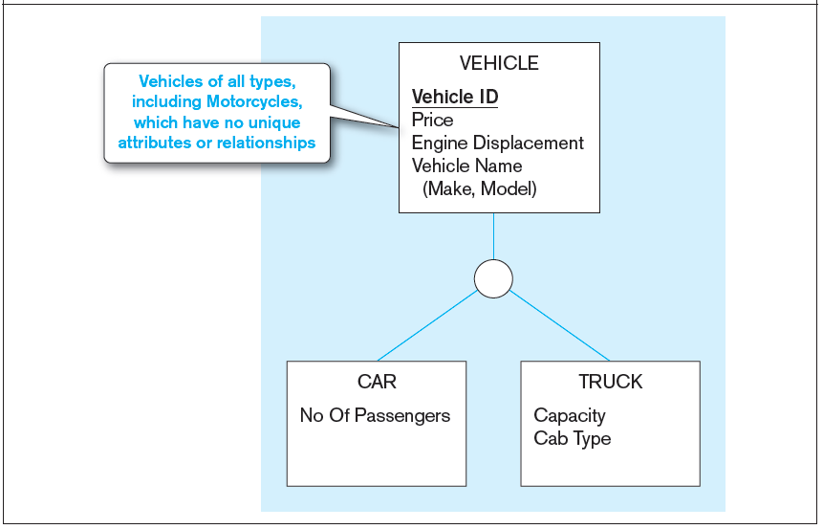
Example of generalization
a) Three entity types: CAR, TRUCK, and MOTORCYCLE
All these types of vehicles have common attributes

Slide 32
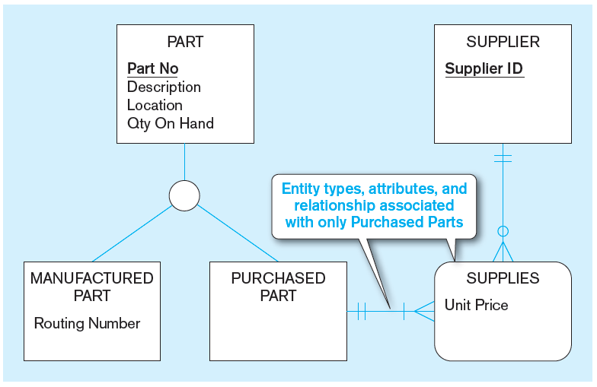
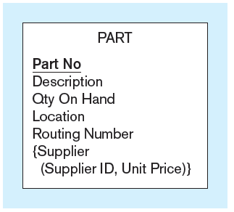
Example of specialization
a) Entity type PART
Only applies to manufactured parts
Applies only to purchased parts

Slide 33
Constraints in Supertype/SUBTYPE RELATIONSHIPS
Completeness Constraints: Whether an instance of a supertype must also be a member of at least one subtype
Total Specialization Rule: Yes (double line)
Partial Specialization Rule: No (single line)
Notes:
There are two types of constraints in supertype/subtype relationships. One is called a completeness constraint, and indicates whether there must be an explicit subtype for each possible instance of the supertype. The other is called a disjointness constraint, which indicates whether a particular instance of a supertype could also be more than one of the subtypes.

Slide 34
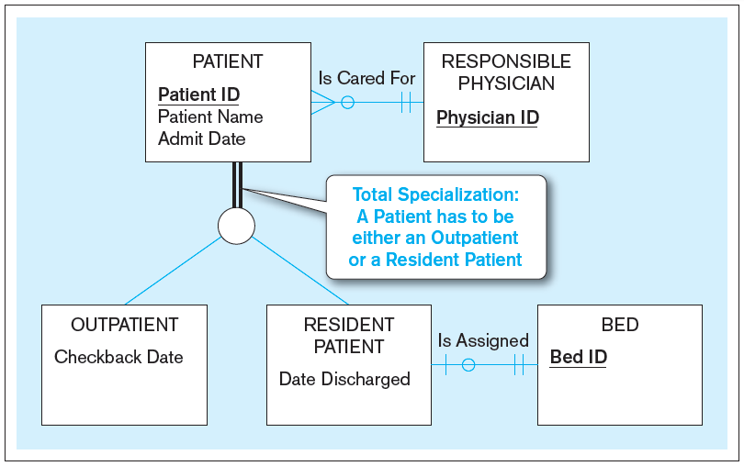
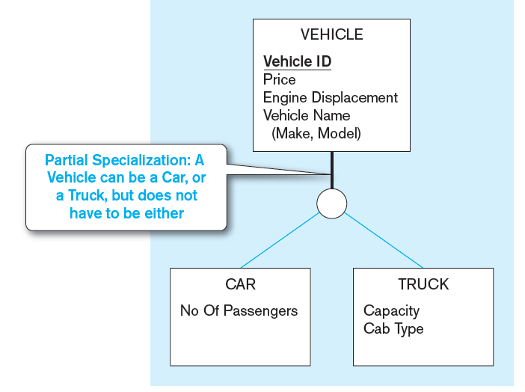
Examples of completeness constraints
a) Total specialization rule
b) Partial specialization rule
Notes:
In this case, a patient MUST either be an outpatient or a resident patient. There is no other possibility. This particular completeness constraint is called total specialization, and is represented by double lines coming down from the supertype entity type.

Slide 35
Constraints in Supertype/SUBTYPE RELATIONSHIPS
Disjointness Constraints: Whether an instance of a supertype may simultaneously be a member of two (or more) subtypes
Disjoint Rule: An instance of the supertype can be only ONE of the subtypes
Overlap Rule: An instance of the supertype could be more than one of the subtypes

Slide 36
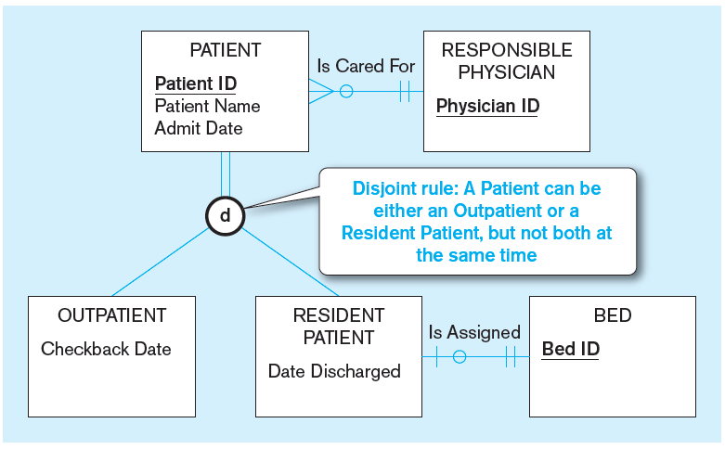
Examples of disjointness constraints
a) Disjoint rule
Notes:
Here we see a disjoint (not overlap) rule regarding patients. A patient can’t be both a resident and an outpatient, at least not at the same time. Of course it’s possible for a patient to be a resident for a period of time and then change to an outpatient (or vice versa), but the patient cannot be both simultaneously.

Slide 37
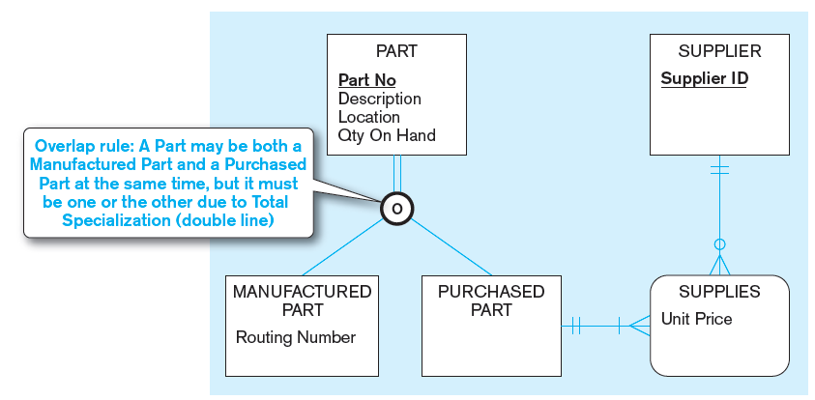
Examples of disjointness constraints (cont.)
b) Overlap rule
Notes:
Here is an overlap rule. Some kinds of parts could be manufactured in-house and also purchased from external suppliers. Note the total specialization rule, which we discussed earlier.

Slide 38
Constraints in Supertype/SUBTYPE RELATIONSHIPS
Subtype Discriminator: An attribute of the supertype whose values determine the target subtype(s)
Disjoint – a simple attribute with alternative values to indicate the possible subtypes
Overlapping – a composite attribute whose subparts pertain to different subtypes. Each subpart contains a Boolean value to indicate whether or not the instance belongs to the associated subtype
Notes:
It is often useful at the supertype level to have an attribute that indicates which subtype an instance is. This is easier to do with the disjoint rule than the overlap rule. For disjoint, there is only one possible subtype, but with overlap there are many. That’s why the overlap rule requires a composite attribute.

Slide 39
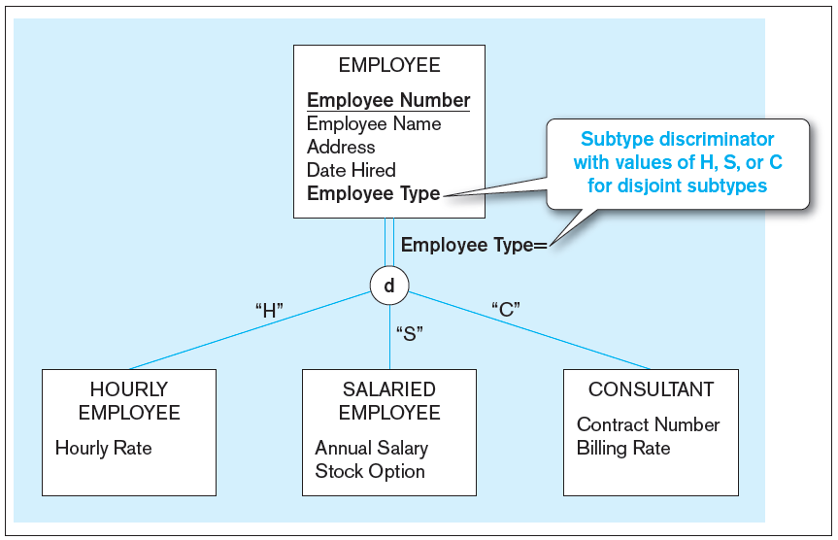
Introducing a subtype discriminator (disjoint rule)
Notes:
Here, for the disjoint rule we have Employee Type as the subtype discriminator, and it can have three possible values, one for each subtype.
what would be a possible subtype discriminator, and what would its values be?

Slide 40
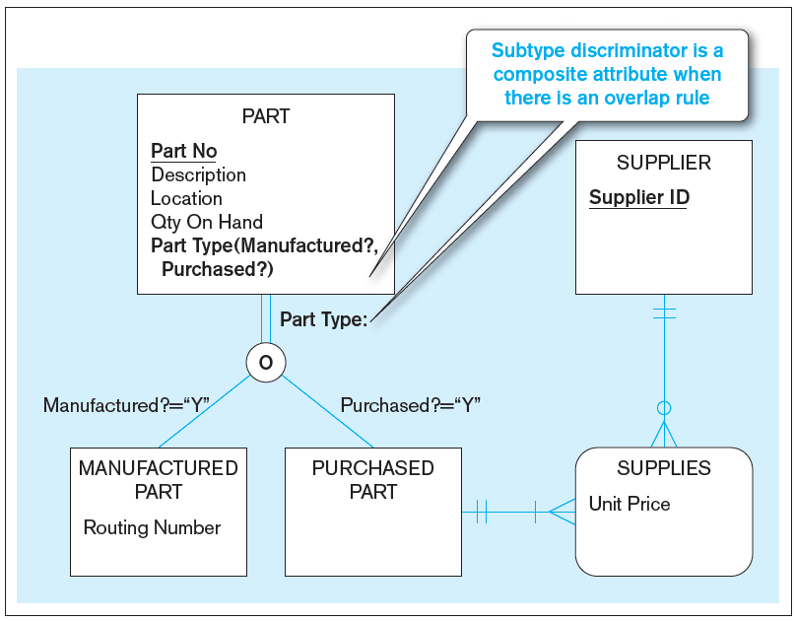
Subtype discriminator (overlap rule)
Notes:
Note the requirement for a composite subtype discriminator here. So, there are three possible scenarios:
Manufactured = “Y” and Purchased = “Y”
Manufactured = “Y” and Purchased = “N”
Manufactured = “N” and Purchased = “N”
Note that it is impossible for this scenario to occur: Manufactured = “N” and Purchased = “N”. Why is this not possible?
Answer: because of the total specialization rule. At least one of these have to be “Y”.

Slide 41
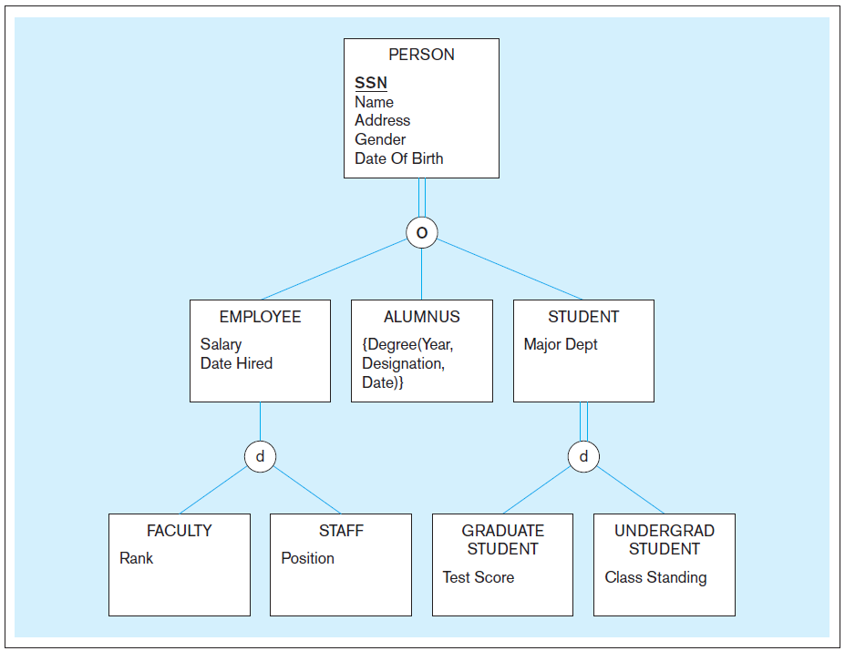
Example of supertype/subtype hierarchy
Notes:
Supertype/subtype hierarchies can be as deep as we want them to be. Here we see that faculty is a type of employee which is a type of person.
Question: Note here that a person must be either an employee, alumnus, or student. Is it possible for a person to be both an employee and a student? Why or why not?
Answer: yes, because of the overlap rule.
Question: Can you envision what the Person’s subtype discriminator would be?
Answer: It has to be a composite attribute.
Question: is it possible for an employee to be something other than Faculty or Staff? Why or why not?
Answer: yes because of partial specialization.
Question: is it possible for an employee to be both faculty and staff?
Answer: No, because of disjoint (not overlap) under Employee.
Question: is it possible for a staff member to also be a graduate student?
Answer: yes, because of the overlap rule under Person.
Question: is it possible for someone to have more than one degree from this university?
Answer: yes because Degree is a multivalued attribute.

Slide 42
Questions?

